Slide 1

Helsinki declaration
Bettercare 2026

Slide 2

Elevator pitch for policymakers

Slide 3
Option 1

Slide 4
The Challenge: Welfare Sustainability & Demographic Reality
The Helsinki Declaration: Future-Proofing European Welfare
The Demographic Shift: Around 52 million Europeans provide informal long-term care, acting as the true structural backbone of our healthcare architectures. With EU long-term care needs projected to rise from 30.8 million to 38.1 million by 2050, ignoring home-care safety is no longer a viable policy option
Notes:
For Policymakers (Focus: System Sustainability & Legislative Reform)
Front (The Challenge: Welfare Sustainability & Demographic Reality)
The Helsinki Declaration: Future-Proofing European Welfare
(The Challenge: Welfare Sustainability & Demographic Reality)
The Helsinki Declaration: Future-Proofing European Welfare
The Demographic Shift: Around 52 million Europeans provide informal long-term care, acting as the true structural backbone of our healthcare architectures. With EU long-term care needs projected to rise from 30.8 million to 38.1 million by 2050, ignoring home-care safety is no longer a viable policy option

Slide 5
The Action: Policy Integration & System Accountability
The Policy Solution: The Declaration, initiated by the BetterCare network (COST Action CA22152), urges governments to formally integrate informal caregiving into national patient safety strategies.
Key Legislative Priorities:
Formal recognition: Explicitly codify informal caregivers as active partners in healthcare legislation.
System accountability: Prevent the "silent transfer" of clinical risks to families without structured funding, preparation, or follow-up.
Comparable metrics: Standardise European indicators to measure home-care errors, caregiver burden, and unmet needs.
🌐 Read the full policy brief: cost-bettercare.eu
Notes:
For Policymakers (Focus: System Sustainability & Legislative Reform)
Back (The Action: Policy Integration & System Accountability)

Slide 6
Option 2

Slide 7
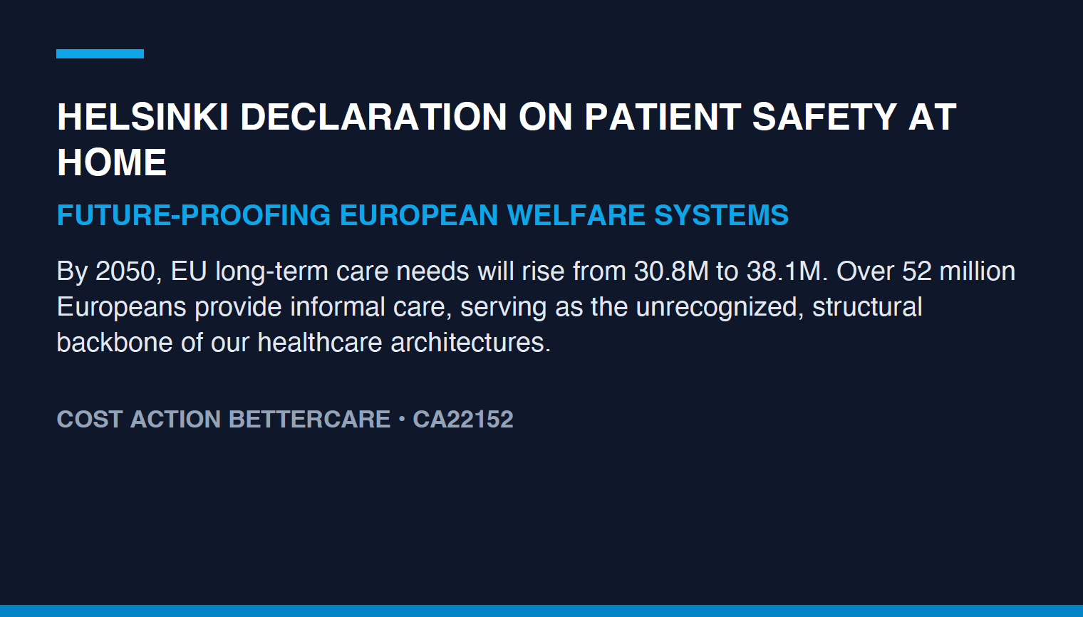
Notes:
For Policymakers (Focus: System Sustainability & Legislative Reform)
Front (The Challenge: Welfare Sustainability & Demographic Reality)
The Helsinki Declaration: Future-Proofing European Welfare
(The Challenge: Welfare Sustainability & Demographic Reality)
The Helsinki Declaration: Future-Proofing European Welfare
The Demographic Shift: Around 52 million Europeans provide informal long-term care, acting as the true structural backbone of our healthcare architectures. With EU long-term care needs projected to rise from 30.8 million to 38.1 million by 2050, ignoring home-care safety is no longer a viable policy option

Slide 8
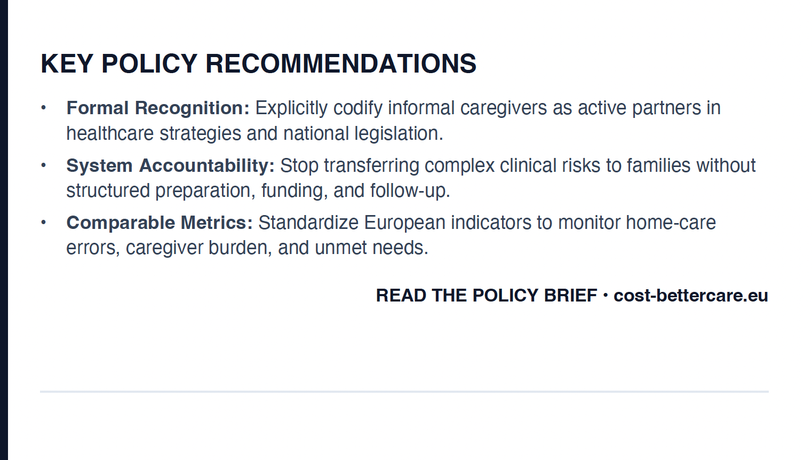
Notes:
For Policymakers (Focus: System Sustainability & Legislative Reform)
Back (The Action: Policy Integration & System Accountability)

Slide 9
Elevator pitch for NGOs

Slide 10
Option 1

Slide 11
The Challenge: The Invisible Workforce & Gender Burden
The Helsinki Declaration: Protecting Those Who Care
The Equity Crisis: Home care is a profoundly gendered issue—women represent 62% of informal long-term care providers in the EU. When health systems fail to support them, these caregivers face severe exhaustion, burnout, and "double victimisation" (suffering intense guilt and distress after preventable home incidents).
Notes:
For NGOs (Focus: Social Equity, Gender Equality, & Caregiver Rights)
Front (The Challenge: The Invisible Workforce & Gender Burden)

Slide 12
The Action: Advocacy, Support, & Dignity
Our Shared Demand: We call on European policy leaders to recognize that safe home care is a human right that requires systemic protection.
Key Advocacy Priorities:
  Minimum safety conditions: Guarantee non-negotiable access to practical training, medication reconciliation, and respite care.
  Non-blaming systems: Establish supportive reporting frameworks for home-care incidents rather than blaming families when systems fail.
  Formalising paid care: Improve working conditions and pension rights for paid home carers to ensure fairness and safety.
  🌐 Join the movement: cost-bettercare.eu
Notes:
For NGOs (Focus: Social Equity, Gender Equality, & Caregiver Rights)
Back (The Action: Advocacy, Support, & Dignity)

Slide 13
Option 2

Slide 14
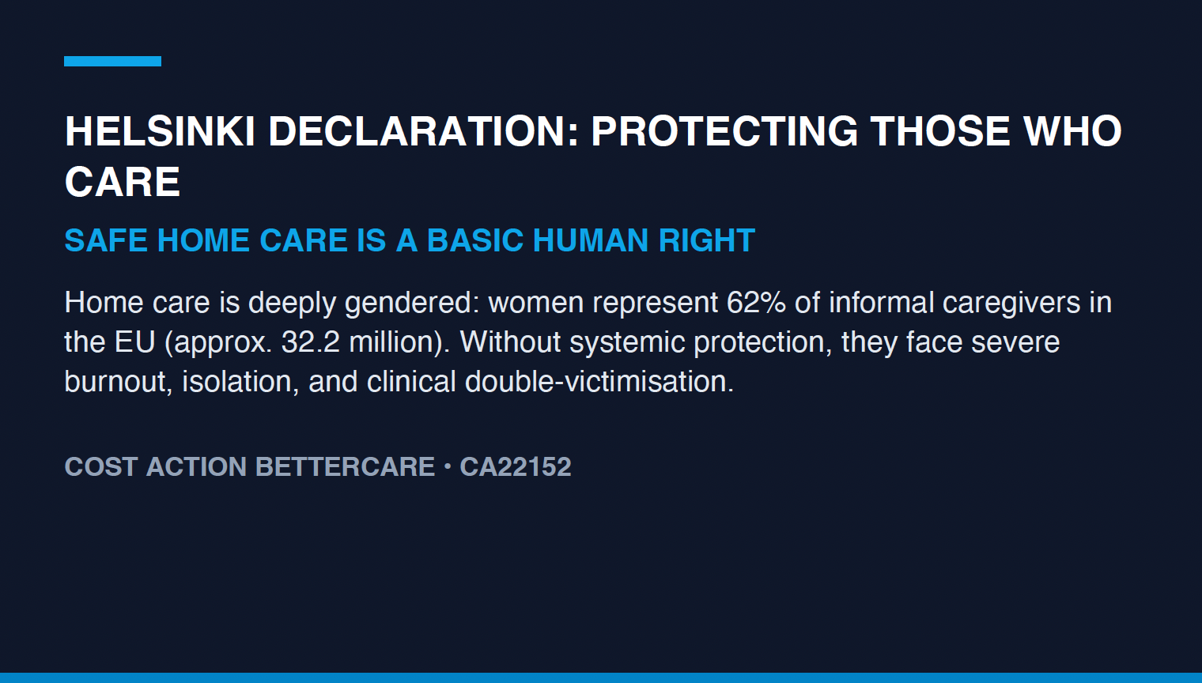

Slide 15
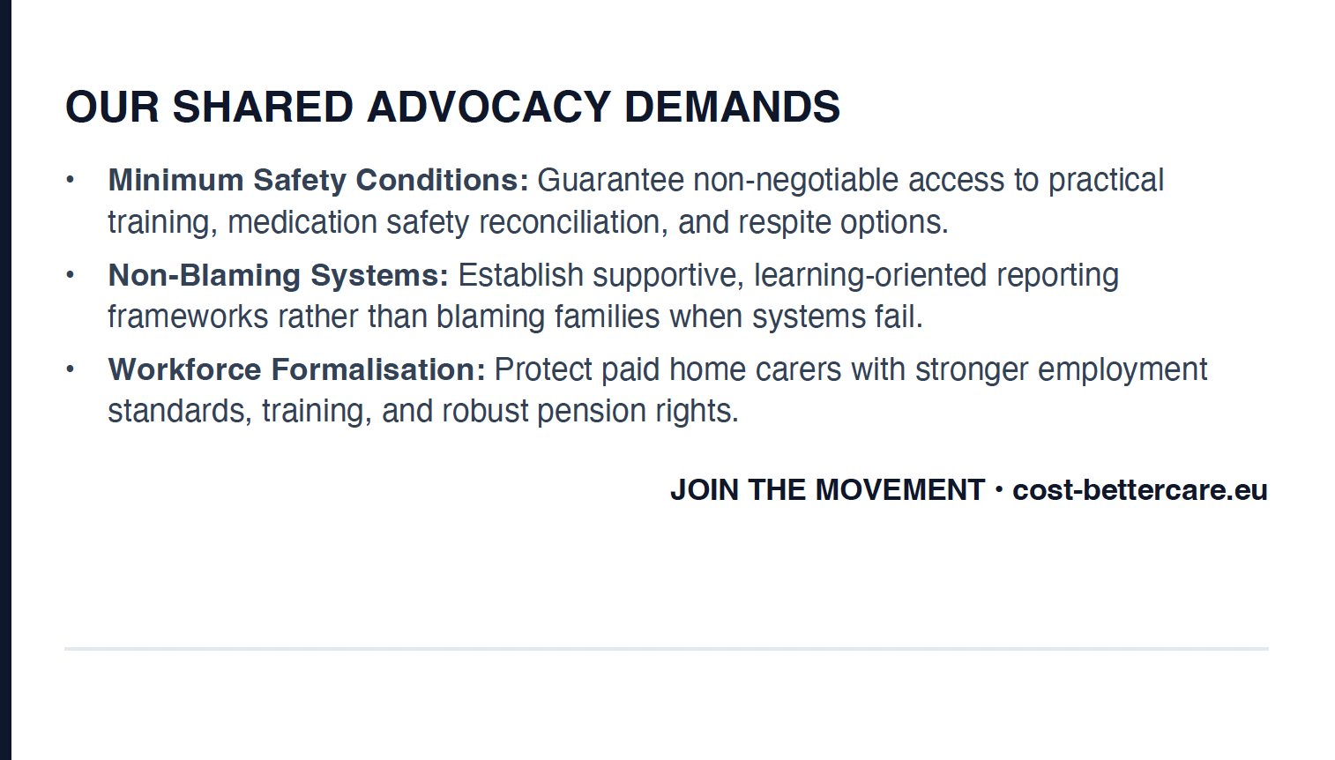

Slide 16

Elevator Pitch for Healthcare Organizations

Slide 17
Option 1

Slide 18
The Challenge: The "Hospital Without Walls”
The Helsinki Declaration: Extending the Clinical Boundary Safely
The Clinical Reality: The home is no longer a passive place of recovery; it is an active, technologically complex site of 24/7/365 care delivery. Fragmented clinical designs leave vulnerable families to navigate disconnected medical and social services entirely on their own.
Notes:
For Health Organisations (Focus: Clinical Integration & Continuity of Care)
Front (The Challenge: The "Hospital Without Walls")

Slide 19
The Action: Clinical Coordination & Error Prevention
The Clinical Solution: Health organisations must actively bridge the gap between institutional medicine and home-based care to improve clinical safety and prevent caregiver errors.
Key Operational Directives:
  Case management: Treat coordination not as admin, but as a practical clinical tool to guide families and manage digital health data.
  Safety as a basic intervention: Treat caregiver training (for medical devices, digital tools, and health literacy) as a fundamental prescription for safe discharge.
  Protecting caregivers to protect patients: Proactively monitor caregiver burnout as a primary clinical risk factor for patient readmission.
🌐 Integrate your care protocols: cost-bettercare.eu
Notes:
For Health Organisations (Focus: Clinical Integration & Continuity of Care)
Back (The Action: Clinical Coordination & Error Prevention)

Slide 20
Option 2

Slide 21


